Slide 1

Critical Design Review
University of Utah Engineering
Clinic 2009-10
December 8,2009

Slide 2
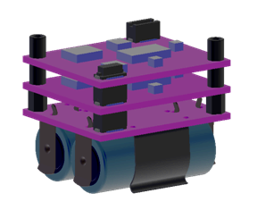
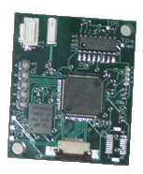
Review
The problem
Last year’s approach
Our proposal
Our progress
Sandia stack
Board from 08/09 team

Slide 3
Project Components
Hardware Design
  Prototypes
  Hardware Improvement
Embedded Programming Design
Software Design

Slide 4
Prototypes
Benefits
  Avoid ruining circuit components
  Easier to test, debug, and modify
  Expedite debugging process
Description

Slide 5
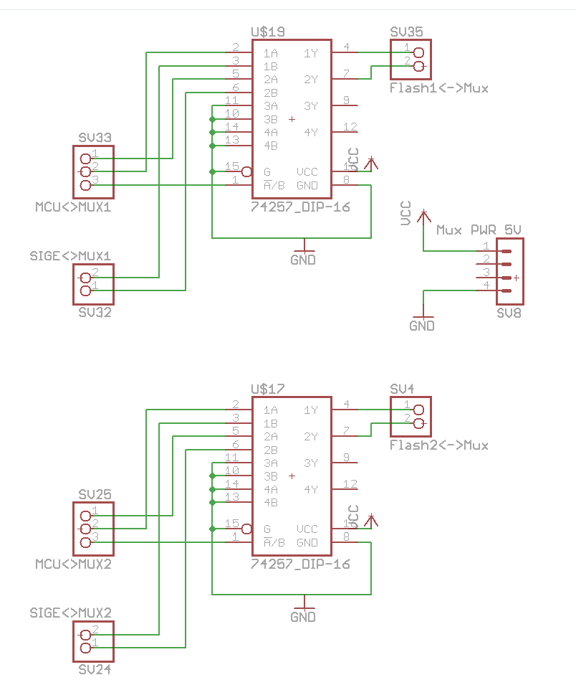
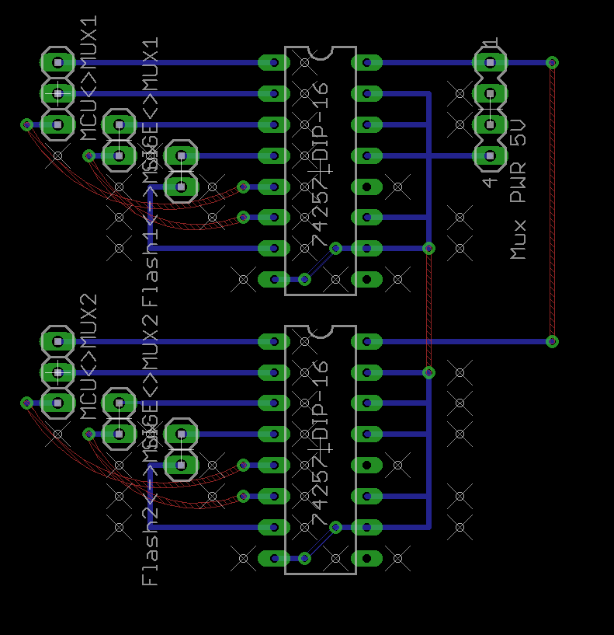
Prototypes
CAD

Slide 6
Prototypes
Construction
  Breakout Boards for
    Accelerometer
    SiGe GPS Receiver
    Flash Memories
    Multiplexer

Slide 7
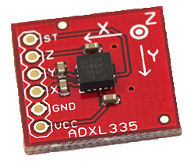
A/D Conversion
Used debugger to establish baseline
Method (for each axis)
  Take average of 10 samples
  on setup
  Take average of 16 for
  other samples
  If average reaches a threshold
  there is movement

Slide 8
A/D Conversion
Works in LPM3 Mode
Settings left at default
  Sampling/Conversion time
  Needs further testing to
  refine

Slide 9
Low Power
The next step:
  Refine the A/D conversion
    More testing
  Add external signal to wake processor up
  (from other boards in the stack)

Slide 10
Flash Memory
Original design flaws
  Page Size 256 bytes
  Time to program page 2.5ms
  Takes .3ms to shift data into flash
  This leaves a 2.2 ms gap in data every .3ms
  Matlab program requires 11ms of uninterrupted signal to do acquisition

Slide 11
Flash Solution
Use two flash chips with larger page size and faster program time
  Micron flash chip page size 2112 bytes
  Time to program 200us avg
  Takes 1.03 ms to shift data in
  Shift data into other flash while first one is programming

Slide 12

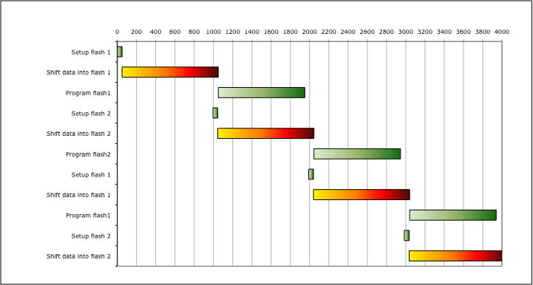
Timeline for writing to flash

Slide 13
RTC (Real Time Clock)
Reason
Old processor
  Outside RTC
New processor
  Inside RTC
Code finished

Slide 14
Communication to PC
Problem
  Connected?
Solution
  PC sends Byte (F5)
  Processor sends ACK (F5)
  Processor sends info
  Processor sends finished message
    (01 02 03 04 05 06 07 08 0a 0b 0c 0d 0e 0f)

Slide 15
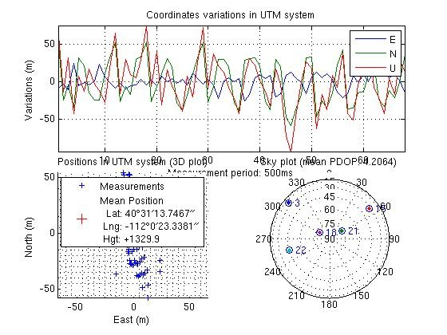
Data Processing
Matlab code
Capture Data
Obtain
coordinates

Slide 16
Updated Time Frame
Task | Projected Completion Date
Testing Prototypes | December 31, 2009
Software Flash/Mux | December 31, 2009
Software SiGe Receiver | December 31, 2009
Software Accelerometer | December 31, 2009
Software Processor | December 31, 2009
GPS Data Processing | January 31, 2010
GUI | January 31,2010

Slide 17
Conclusion
Where we go from here
  Refine and test current code
  Write SiGe data to flash
  Add external wakeup signal from stack
  UART to send data to PC
  Web service for data lookup (GAMIT)
  Application to display data

